Slide 1
A Tutorial on Bayesian Networks
Partially taken from
Weng-Keen Wong
School of Electrical Engineering and Computer Science
Oregon State University

Slide 2
Introduction
Suppose you are trying to determine if a patient has pneumonia. You observe the following symptoms:
The patient has a cough
The patient has a fever
The patient has difficulty breathing

Slide 3
Introduction
You would like to determine how likely the patient has pneumonia given that the patient has a cough, a fever, and difficulty breathing
We are not 100% certain that the patient has pneumonia because of these symptoms. We are dealing with uncertainty!

Slide 4
Introduction
Now suppose you order a chest x-ray and the results are positive.
Your belief that that the patient has pneumonia is now much higher.

Slide 5
Introduction
In the previous slides, what you observed affected your belief that the patient has pneumonia
This is called reasoning with uncertainty
Wouldn’t it be nice if we had some methodology for reasoning with uncertainty? Why in fact, we do...

Slide 6
Bayesian Networks
Bayesian networks help us reason with uncertainty
In the opinion of many AI researchers, Bayesian networks were the most significant contribution in AI between 1990s and 2000s.
They are used in many applications eg.:
Spam filtering / Text mining
Speech recognition
Robotics
Diagnostic systems
Syndromic surveillance

Slide 7
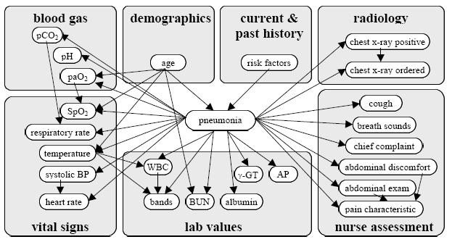
Bayesian Networks (An Example)
From: Aronsky, D. and Haug, P.J., Diagnosing community-acquired pneumonia with a Bayesian network, In: Proceedings of the Fall Symposium of the American Medical Informatics Association, (1998) 632-636.

Slide 8
Outline
Introduction
Probability Primer
Bayesian networks
Bayesian networks in syndromic surveillance

Slide 9
Probability Primer: Random Variables
A variable called random variable because : They can take on different values. Their values are uncertain and described by probabilities.
A random variable is the basic element of probability
Refers to an event and there is some degree of uncertainty as to the outcome of the event
For example, the random variable A could be the event of getting a heads on a coin flip

Slide 10
Boolean Random Variables
We deal with the simplest type of random variables – Boolean ones
Take the values true or false
Think of the event as occurring or not occurring
Examples (Let A be a Boolean random variable):
A = Getting heads on a coin flip
A = It will rain today
A = There is a typo in these slides

Slide 11
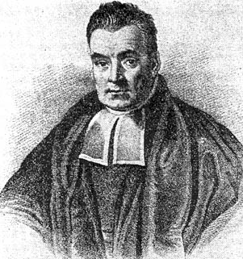
Probabilities
We will write P(A = true) to mean the probability that A = true.
What is probability? It is the relative frequency with which an outcome would be obtained if the process were repeated a large number of times under similar conditions*
The sum of the red and blue areas is 1
P(A = true)
*Ahem…there’s also the Bayesian definition which says probability is your degree of belief in an outcome
P(A = false)

Slide 12
Conditional Probability
P(A = true | B = true) = Out of all the outcomes in which B is true, how many also have A equal to true
Read this as: “Probability of A conditioned on B” or “Probability of A given B”
H = “Have a headache”
F = “Coming down with Flu”
P(H = true) = 1/10
P(F = true) = 1/40
P(H = true | F = true) = 1/2
“Headaches are rare and flu is rarer, but if you’re coming down with flu there’s a 50-50 chance you’ll have a headache.”
P(F = true)
P(H = true)

Slide 13
The Joint Probability Distribution
We will write P(A = true, B = true) to mean “the probability of A = true and B = true”
Notice that:
P(H=true|F=true)
P(F = true)
P(H = true)
In general, P(X|Y)=P(X,Y)/P(Y)
P(X|Y) = P(X) P(Y|X) /P(Y)

Slide 14
The Joint Probability Distribution
Joint probabilities can be between any number of variables
eg. P(A = true, B = true, C = true)
For each combination of variables, we need to say how probable that combination is
The probabilities of these combinations need to sum to 1
A | B | C | P(A,B,C)
false | false | false | 0.1
false | false | true | 0.2
false | true | false | 0.05
false | true | true | 0.05
true | false | false | 0.3
true | false | true | 0.1
true | true | false | 0.05
true | true | true | 0.15
Sums to 1

Slide 15
The Joint Probability Distribution
A | B | C | P(A,B,C)
false | false | false | 0.1
false | false | true | 0.2
false | true | false | 0.05
false | true | true | 0.05
true | false | false | 0.3
true | false | true | 0.1
true | true | false | 0.05
true | true | true | 0.15
Once you have the joint probability distribution, you can calculate any probability involving A, B, and C
Note: May need to use marginalization and Bayes rule, (both of which are not discussed in these slides)
Examples of things you can compute:
P(A=true) = sum of P(A,B,C) in rows with A=true
P(A=true, B = true | C=true) =
P(A = true, B = true, C = true) / P(C = true)

Slide 16
The Problem with the Joint Distribution
Lots of entries in the table to fill up!
For k Boolean random variables, you need a table of size 2^{k}
How do we use fewer numbers? Need the concept of independence
A | B | C | P(A,B,C)
false | false | false | 0.1
false | false | true | 0.2
false | true | false | 0.05
false | true | true | 0.05
true | false | false | 0.3
true | false | true | 0.1
true | true | false | 0.05
true | true | true | 0.15

Slide 17
Independence
Variables A and B are independent if any of the following hold:
P(A,B) = P(A) P(B)
P(A | B) = P(A)
P(B | A) = P(B)
This says that knowing the outcome of A does not tell me anything new about the outcome of B.

Slide 18
Independence
How is independence useful?
Suppose you have n coin flips and you want to calculate the joint distribution P(C₁, …, C_{n})
If the coin flips are not independent, you need 2^{n} values in the table
If the coin flips are independent, then
Each P(C_{i}) table has 2 entries and there are n of them for a total of 2n values

Slide 19
Conditional Independence
Variables A and B are conditionally independent given C if any of the following hold:
P(A, B | C) = P(A | C) P(B | C)
P(A | B, C) = P(A | C)
P(B | A, C) = P(B | C)
Knowing C tells me everything about B. I don’t gain anything by knowing A (either because A doesn’t influence B or because knowing C provides all the information knowing A would give)

Slide 20
Outline
Introduction
Probability Primer
Bayesian networks
Bayesian networks in syndromic surveillance

Slide 21
A Bayesian Network
A Bayesian network is made up of:
1. A Directed Acyclic Graph
A
B
C
D
2. A set of tables for each node in the graph
A | P(A)
false | 0.6
true | 0.4
A | B | P(B|A)
false | false | 0.01
false | true | 0.99
true | false | 0.7
true | true | 0.3
B | D | P(D|B)
false | false | 0.02
false | true | 0.98
true | false | 0.05
true | true | 0.95
B | C | P(C|B)
false | false | 0.4
false | true | 0.6
true | false | 0.9
true | true | 0.1

Slide 22
A Directed Acyclic Graph
Each node in the graph is a random variable
A node X is a parent of another node Y if there is an arrow from node X to node Y eg. A is a parent of B
A
B
C
D
Informally, an arrow from node X to node Y means X has a direct influence on Y

Slide 23
A Set of Tables for Each Node
A | P(A)
false | 0.6
true | 0.4
A | B | P(B|A)
false | false | 0.01
false | true | 0.99
true | false | 0.7
true | true | 0.3
Each node X_{i} has a conditional probability distribution P(X_{i} | Parents(X_{i})) that quantifies the effect of the parents on the node
The parameters are the probabilities in these conditional probability tables (CPTs)
B | C | P(C|B)
false | false | 0.4
false | true | 0.6
true | false | 0.9
true | true | 0.1
A
B
B | D | P(D|B)
false | false | 0.02
false | true | 0.98
true | false | 0.05
true | true | 0.95
C
D

Slide 24
A Set of Tables for Each Node
Conditional Probability Distribution for C given B
B | C | P(C|B)
false | false | 0.4
false | true | 0.6
true | false | 0.9
true | true | 0.1
For a given combination of values of the parents (B in this example), the entries for P(C=true | B) and P(C=false | B) must add up to 1
eg. P(C=true | B=false) + P(C=false |B=false )=1

Slide 25
Conditional Independence
The Markov condition: given its parents (P₁, P₂),
a node (X) is conditionally independent of its non-descendants (ND₁, ND₂)
P₁
P₂
ND₁
X
ND₂
C₁
C₂

Slide 26
The Joint Probability Distribution
Due to the Markov condition, we can compute the joint probability distribution over all the variables X₁, …, X_{n} in the Bayesian net using the formula:
Where Parents(X_{i}) means the values of the Parents of the node X_{i} with respect to the graph

Slide 27
Using a Bayesian Network Example
Using the network in the example, suppose you want to calculate:
P(A = true, B = true, C = true, D = true)
= P(A = true) * P(B = true | A = true) *
P(C = true | B = true) P( D = true | B = true)
= (0.4)*(0.3)*(0.1)*(0.95)
A
B
C
D

Slide 28
Using a Bayesian Network Example
Using the network in the example, suppose you want to calculate:
P(A = true, B = true, C = true, D = true)
= P(A = true) * P(B = true | A = true) *
P(C = true | B = true) P( D = true | B = true)
= (0.4)*(0.3)*(0.1)*(0.95)
This is from the graph structure
A
B
These numbers are from the conditional probability tables
C
D

Slide 29
Example 1
We aim to predict whether a person has the flu based on symptoms such as fever, cough, and fatigue. The assumption is that flu causes these symptoms, and they are conditionally independent given the flu.

Slide 30
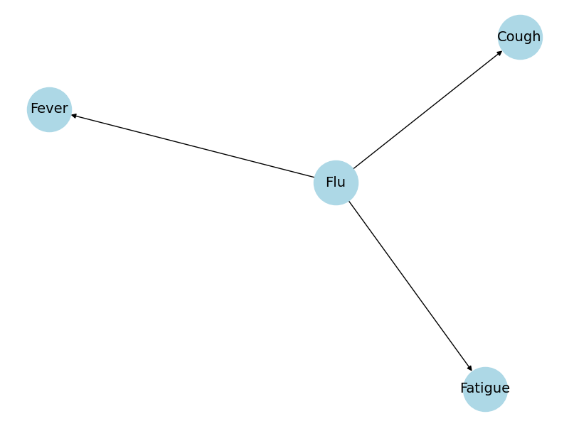
Example 1
Network Structure
The Bayesian Network structure is as follows:
Flu → Fever, Cough, Fatigue

Slide 31
Example 1
Conditional Probability Tables (CPTs)
P(Flu): Yes: 0.1 No: 0.9
P(Fever | Flu): Flu=Yes: Yes: 0.8, No: 0.2 Flu=No: Yes: 0.3, No: 0.7
P(Cough | Flu): Flu=Yes: Yes: 0.7, No: 0.3 Flu=No: Yes: 0.2, No: 0.8
P(Fatigue | Flu): Flu=Yes: Yes: 0.6, No: 0.4 Flu=No: Yes: 0.3, No: 0.7

Slide 32
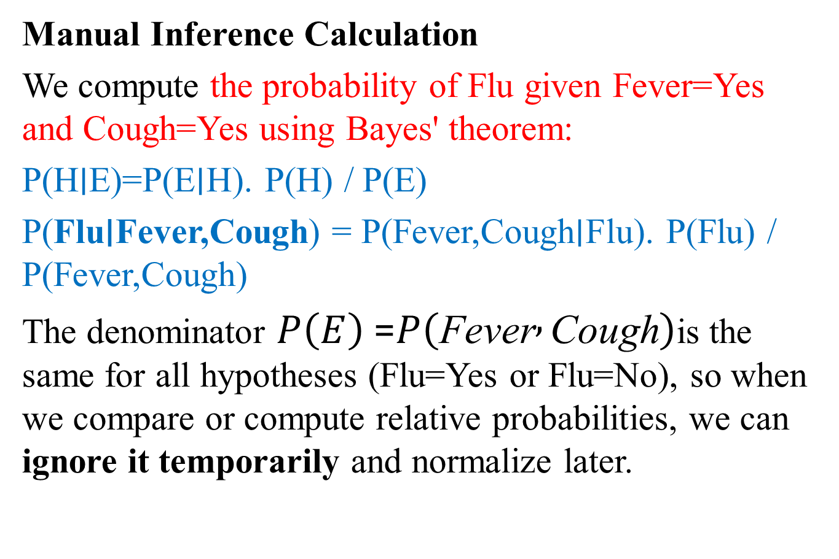
Example 1
Manual Inference Calculation
We compute the probability of Flu given Fever=Yes and Cough=Yes using Bayes' theorem:
P(H∣E)=P(E∣H)​. P(H) / P(E)
P(Flu∣Fever,Cough) = P(Fever,Cough∣Flu)​. P(Flu) / P(Fever,Cough)
The denominator $P\left(E\right)$= $P\left(\text{Fever} , \text{Cough}\right)$is the same for all hypotheses (Flu=Yes or Flu=No), so when we compare or compute relative probabilities, we can ignore it temporarily and normalize later.

Slide 33
Example 1
Note:
P(E)=all hypotheses∑​P(H)⋅P(E∣H)
P(Fever,Cough)=∑​P(Flu)⋅P(Fever,Cough∣Flu)
flu
P(Flu | Fever, Cough) ∝ P(Flu) × P(Fever|Flu) × P(Cough|Flu)
For Flu=Yes: 0.1 × 0.8 × 0.7 = 0.056
For Flu=No: 0.9 × 0.3 × 0.2 = 0.054
P(E) = 0.056 + 0.509 = 0.11
P(Flu=Yes∣Fever, Cough)= 0.056/0.11​≈ 0.509
Normalized: P(Flu=Yes) ≈ 0.509
P(Flu = No ∣Fever, Cough) 0.054 / 0.11 ≈ 0.491

Slide 34
Example 1
So, there's approximately a 51% chance of having the flu given fever and cough.

Slide 35
Example 2
We want to determine the probability that an email is spam based on the following features: - ContainsOffer: Whether the email contains promotional offers.
- ContainsLink: Whether the email contains hyperlinks.
- SenderKnown: Whether the sender is known to the recipient.

Slide 36
Example 2

Slide 37
Example 2
The Bayesian Network structure is as follows:
Spam influences ContainsOffer, ContainsLink, and SenderKnown.
This means these features are conditionally dependent on whether the email is spam.
Graphical representation:
Spam → ContainsOffer Spam → ContainsLink Spam → SenderKnown

Slide 38
Example 2
Conditional Probability Tables (CPTs)
P(Spam):
Spam=Yes: 0.3
Spam=No: 0.7
P(ContainsOffer | Spam):
Spam=Yes: {Yes: 0.8, No: 0.2}
Spam=No: {Yes: 0.1, No: 0.9}

Slide 39
Example 2
P(ContainsLink | Spam):
Spam=Yes: {Yes: 0.9, No: 0.1}
Spam=No: {Yes: 0.4, No: 0.6}
P(SenderKnown | Spam):
Spam=Yes: {Yes: 0.2, No: 0.8}
Spam=No: {Yes: 0.9, No: 0.1}

Slide 40
Example 2
Manual Inference Calculation
Suppose we observe an email with the following features: - ContainsOffer = Yes - ContainsLink = Yes - SenderKnown = No
We want to compute P(Spam | ContainsOffer=Yes, ContainsLink=Yes, SenderKnown=No).

Slide 41
Example 2
Using Bayes' theorem:
P(Spam | Evidence) ∝ P(Spam) × P(ContainsOffer | Spam) × P(ContainsLink | Spam) × P(SenderKnown | Spam)
For Spam=Yes:
0.3 × 0.8 × 0.9 × 0.8 = 0.1728
For Spam=No:
0.7 × 0.1 × 0.4 × 0.1 = 0.0028

Slide 42
Example 2
Normalize:
Total = 0.1728 + 0.0028 = 0.1756
P(Spam=Yes | Evidence) = 0.1728 / 0.1756 ≈ 0.984
P(Spam=No | Evidence) = 0.0028 / 0.1756 ≈ 0.016

Slide 43
Example 3
Problem Definition
We consider a medical diagnosis scenario with the following variables: - Disease (Yes/No) - TestPositive (Yes/No) - Symptom (Yes/No) The structure of the network is:
Disease → TestPositive and
Disease → Symptom.

Slide 44
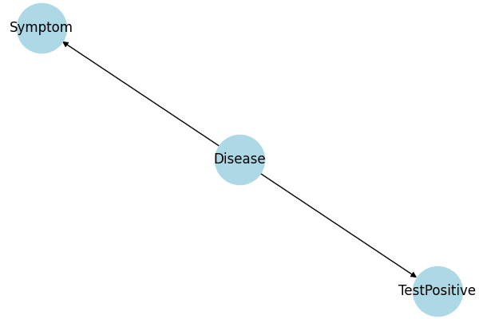
Example 3

Slide 45
Example 3
Conditional Probability Tables (CPTs)
P(Disease): Yes: 0.05, No: 0.95
P(TestPositive | Disease):
Disease=Yes: Yes: 0.9, No: 0.1
Disease=No: Yes: 0.2, No: 0.8
P(Symptom | Disease):
Disease=Yes: Yes: 0.8, No: 0.2
Disease=No: Yes: 0.1, No: 0.9

Slide 46
Example 3
Step-by-Step Joint Probability Calculation
Joint Probability Calculation
Using the formula: P(X1,...,Xn) = ∏ P(Xi | Parents(Xi)
Example: Compute P(Disease=Yes, TestPositive=Yes, Symptom=Yes)
Using the formula:
P(D, T, S) = P(D) × P(T|D) × P(S|D)
= 0.05 × 0.9 × 0.8 = 0.036
Another example: P(Disease=No, TestPositive=Yes, Symptom=Yes)
= 0.95 × 0.2 × 0.1 = 0.019

Slide 47
Example 4
This example demonstrates a Bayesian Network with both dependent and independent variables. We use a realistic scenario involving Weather, Traffic, Accident, and LateForWork.
Network Structure
The structure of the network is as follows:
- Weather influences Traffic and LateForWork
- Traffic influences Accident
- Accident influences LateForWork

Slide 48
Example 4
Network Structure
The structure of the network is as follows:
- Weather influences Traffic and LateForWork
- Traffic influences Accident
- Accident influences LateForWork
Some variables like Traffic and Accident are dependent, while others like Weather are independent of Accident.

Slide 49
Example 4
Conditional Probability Tables (CPTs)
P(Weather): {Sunny: 0.6, Rainy: 0.4}
P(Traffic | Weather):
- Weather=Sunny: {Heavy: 0.3, Light: 0.7}
- Weather=Rainy: {Heavy: 0.8, Light: 0.2}
P(Accident | Traffic):
- Traffic=Heavy: {Yes: 0.6, No: 0.4}
- Traffic=Light: {Yes: 0.2, No: 0.8}

Slide 50
Example 4
P(LateForWork | Weather, Accident):
-Weather=Sunny, Accident=No: {Yes: 0.2, No: 0.8}
- Weather=Sunny, Accident=Yes: {Yes: 0.6, No: 0.4}
- Weather=Rainy, Accident=No: {Yes: 0.5, No: 0.5}
- Weather=Rainy, Accident=Yes: {Yes: 0.9, No: 0.1}

Slide 51
Example 4
Step-by-Step Joint Probability Calculation
Example: Compute P(Weather=Rainy, Traffic=Heavy, Accident=Yes, LateForWork=Yes)
Using the factorization formula:
P(W, T, A, L) = P(W) * P(T|W) * P(A|T) * P(L|W, A)
= 0.4 * 0.8 * 0.6 * 0.9 = 0.1728

Slide 52
Example 4
The previous example illustrates how Bayesian Networks can model complex dependencies. Some variables like Traffic and Accident are dependent, while others like Weather are independent of Accident.

Slide 53
Example 4
Example: Compute P(Weather=Sunny, Traffic=Heavy, Accident=No, LateForWork=Yes)
P(W, T, A, L) = P(W) * P(T|W) * P(A|T) * P(L|W, A)
P(W=Sunny) = 0.4
P(T=H | W=S) = 0.3
P(A = N | T=H) = 0.4
P(L = yes| W =S,A = N)= 0.2
= 0.4 * 0.3 * 0.4 * 0.2 = 0.009

Slide 54
A comprehensive Example
Diago-1 | Diago-2 | Diago-3 | Diago-4 | Disease
T | T | T | T | Y
F | T | T | T | Y
T | F | T | T | N
F | F | T | T | N
T | T | F | T | N
F | T | F | T | Y
T | F | F | T | N
F | F | F | T | N
T | T | T | F | Y
F | T | T | F | N
T | F | T | F | N
F | F | T | F | Y

Slide 55
A comprehensive Example
The Bayesian Network is
Disease → diago-1
Disease → diago-2
Disease → diago-3
Disease → diago-4

Slide 56
A comprehensive Example
P(Dis) = yes 5/12 = 0.41
P(Dis) = No 7/12 = 0.583
P(d1|Dis)
Dis:Yes d1= T 2/5 = 0.4 d2=F 3/5=0.6
Dis: No d1=T 4/7 = 0.571 d2= F 3/7= 0.428

Slide 57
A comprehensive Example
P(d2|Dis)
Dis: Yes d2=T 4/5=0.8 d2=F 1/5=0.2
Dis: No d2 = 2/7= 0.285 d2=F 5/7=0.714
P(d3|Dis)
Dis:Yes d3=T 4/5=0.8 d3= F 1/5=0.2
Dis: No d3=T 4/7 =0.571 dis3=F 2/7 =0.285
P(d3|Dis)
Dis: Yes d4=T 3/5= 0.6 d4=F 2/5= 0.4
Dis: No d4=T 5/7 = 0.714 d4=F 2/7 = 0.285

Slide 58
A comprehensive Example
Given d1=T d2= F d3 =F d4=T
Find probability of disease given d1,d2,d3 and d4 Using the product formula of Bayesian Network
P(dis=Y |d1=T,d2=F,d3=F,d4=T) proportional to
P(dis=Y) x P(d1=T|dis=Y) x P(d2=F|dis=Y) x
P(d3=F | dis=Y) x P(d4=T|dis=Y)
= 0.41 x 0.4 x 0.2 x 0.2 x 0.6 = 0.0039

Slide 59
A comprehensive Example
P(dis=N |d1=T,d2=F,d3=F,d4=T) proportional to
P(dis=N x P(d1=T|dis=N) x P(d2=F|dis=N) x P(d3=F | dis=N) x P(d4=T|dis=N)
= 0.583 X 0.571 X 0.714 X 0.286 X 0.714 = 0.0486
We do normalization
0.0039 +0.0486 = 0.0525
P(dis=Y |d1=T,d2=F,d3=F,d4=T) = 0.0039 / 0.0525 = 0.0743
P(dis=N |d1=T,d2=F,d3=F,d4=T) = 0.0486 / 0.0525 = 0.926
This means Disease equal to NO

Slide 60
A comprehensive Example
Find probability of Disease given that d1 = T and d2=T
P(dis=Y| d1=T, d2=T) Proportional to P(dis=Y) x P(d1=T|dis=Y) x P(d2=T|dis=Y)
P(dis=N| d1=T, d2=T) Proportional to P(dis=N) x P(d1=T|dis=N) x P(d2=T|dis=N)
P(dis=Y| d1=T, d2=T) = 0.41X 0.4 X 0.8 = 0.131
P(dis=N| d1=T, d2=T) = 0.583 x 0.571 x 0.285= 0.095

Slide 61
A comprehensive Example
For normalization
0.131 + 0.095 = 0.227
For dis = Y 0.131/ 0.227 = 0.577
For dis = N 0.095/ 0.227 = 0.419
The prediction is that, the patient will have a disease.

